Slide 1
PREVENTION AND DETECTION OF FAKE CHEQUE SCAMS USING BLOCK CHAIN
BATCH A13
SRIMANJARI P [211418104262]
SUBRINI K B [211418104270]
SWETHA A R [211418104283]
TEAM MEMBERS
GUIDE NAME: Mrs S.T.SANTHANALAKSHMI

Slide 2
INTRODUCTION
In our current society, cheques represent one of the dominant payment methods.
A cheque is an order written by a depositor instructing the bank to pay a specific amount to a recipient from the depositor’s bank account.
Unfortunately, numerous malicious scammers exploit some flaws in the banking system to commit frauds.
Indeed, frauds employing fake cheques are growing rapidly and cost billions of money. we focus on fake cheque scams.
This fraud is achieved getting people mainly through some email scam; establishing a relationship a business relationship most of the time sending them overpaid counterfeit paycheck; and finally asking for the overpayment.

Slide 3
ABSTRACT
Fake cheque scam is one of the most common attacks used to commit fraud against consumers.
Currently, there is no existing solution to authenticate cheque and detect fake ones instantly.
Instead, banks must wait for a period of more time and date to detect the scam.
More precisely, our approach helps the banks to share information about provided cheque and used ones, without exposing the banks customers personal data. Fake cheque scome in many forms.
They might look like business or personal cheques, cashier’s cheque, money orders, or a cheque delivered electronically.

Slide 4
EXISTING SYSTEM
Fake cheque scam has more disastrous consequences on the victims than many other attacks.
In this context, we believe that the best solution to protect users is the detection of fake cheques well before they are cashed.
Technique:
Digital Signature Algorithm

Slide 5
DISADVANTAGE
It calls for lot of time for computation.
Verification of a given take a look at and, for this reason, avoid the modern drift duration of greater than 48 h.

Slide 6
PROPOSED SYSTEM
To verify the authenticity of a given cheque, without exposing the banks’ customers’ personal data.
To evaluate the performance of our proposed approach, we also deployed our cheque’s authentication scheme based on the blockchain.
Technique:
SHA algorithm

Slide 7
ADVANTAGE
It requires less time for computation.
Data transaction is extra cozy manner to client and charity through bank.
Bank asking validated consumer and client give the permission the financial institution may be send the cash in charity.

Slide 8
PROCESSOR : DUAL CORE 2 DUOS
RAM : 2 GB DD RAM
HARD DISK : 250 GB
HARDWARE REQUIREMENTS

Slide 9
SOFTWARE REQUIREMENTS
FRONT END : J2EE (JSP, SERVLET)
BACK END : MY SQL 5.5
OPERATING SYSTEM : WINDOWS 7
IDE : ECLIPSE

Slide 10
MODULES
CHARITY REGISTER
CHARITY LOGIN
CHARITY REQUEST
CHARITY REQUEST VIEW
CHARITY DONATION VIEW
BANK RESPONSE VIEW
VIEW ACCOUNT BALANACE

Slide 11
MODULES
PUBLIC REGISTER
PUBLIC LOGIN
VIEW CHARITY REQUEST
RESPONSE(BANK)
ADMIN LOGIN
VIEW CHARITY REQUEST
RESPONSE

Slide 12
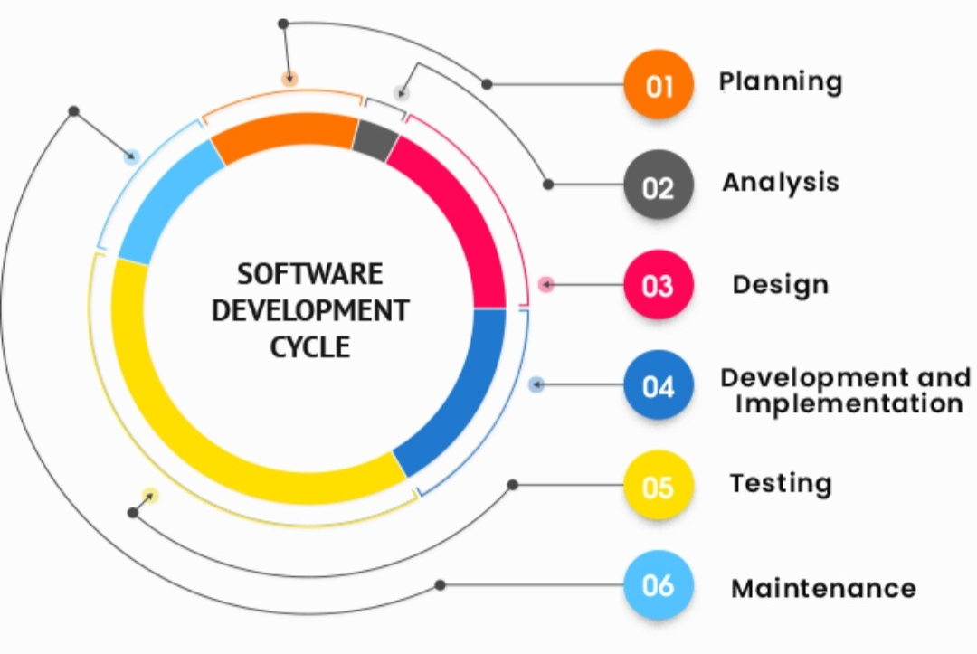
SDLC MODEL

Slide 13
TIME LINE CHART
project
submission
5
4
Implementation
and Testing
UML diagrams
are produced
Modules are
tested
3
Implementation
Of each
module
2
Start of the
project
1
0
Review 0
Review 1
Review 2
Review 3
Review 4

Slide 14
REFERENCE
[1] Badis Hammi , Sherali Zeadally , Yves Christian Elloh Adja, Manlio Del Giudice, and Jamel Nebhen,2021, “Blockchain-Based Solution for Detecting and Preventing Fake Check Scams”.
[2] Emart 77, Beirut, Lebanon,2021,“ The Role of Blockchain in Reducing the Cost of Financial Transactions in the Retail Industry”.
[3] Dilip Kumar Sharma; Sonal Garg; Priya Shrivastava ,2021,“ Evaluation of Tools and Extension for Fake News Detection”.
[4] Vikash Kumar Aggarwal , Nikhil Sharma , Ila Kaushik , Bharat Bhushan , Himanshu, 2020, “Integration of Blockchain and IoT (B-IoT): Architecture, Solutions, & Future Research Direction”.
[5] Jackie Jones, Damon McCoy,2020,“The Check is in the Mail: Monetization of Craigslist Buyer Scams”.
[6] Abiola, Idowu,2019,“ An Assessment of Fraud and its Management in Nigeria Commercial Banks”.
[7] Sumeet Kumar,2018, “Simulating DDOS attacks on the us fiber-optics internet infrastructure”.
[8]Nazli Ismail Nawang,2017, “Combating anonymous offenders in the cyberspace: An overview of the legal approach in Malaysia”.
[9]Haris Šemić, Sasa Mrdovic,2017, “IoT honeypot: A multi-component solution for handling manual and Mirai-based attacks”.

Slide 15
[10] Bernie S. Fabito, Angelique D. Lacasandile, Emeliza R. Yabut ,2017,“ : Leveraging crime reporting in Metro Manila using unsupervised crowd-sourced data: A case for the Report framework”.
[11] Wendy Baker-Smemoe, Chair David Eddington William G. Eggington,2015,“ The Language and Cross-Cultural Perceptions of Deception”.
[12] S. Baker, 2018, “Don’t cash that cheque: BBB study shows how fake cheque scams bait consumers”, Tech. Rep., Better Bus. Bureau, Arlington County, VA, USA, Sep.
[13] L. M. Rose, 2018, “Modernizing cheque fraud detection with machine learning”, Ph.D. dissertation, Dept. Financial Crime Compliance Manage., Utica College, Utica, NY, USA.
[14] Federal Trade Commission, 2018, “Consumer sentinel network data book 2017”, FederalTrade Commission,Washington, DC, USA,Tech. Rep., Mar.
[15] C. Tressler, 2020, “FTC: The bottom-line on fake cheques scams”, Federal Trade Commission, Washington, DC, USA, Tech. Rep., Feb.
[16] “2017 Internet crime report,” Federal Bureau of Investigation/Internet Crime Complaint Center, Washington, DC, USA, Tech. Rep., 2018.
[17] K. Pak and D. Shadel, 2011, “AARP Foundation national fraud victim study”, AARP Foundation, Washinton, DC, USA, Tech. Rep..
[18] C.-D. Chen and L.-T. Huang, 2011, “Online deception investigation: Content analysis and cross-cultural comparison”, Int. J. Bus. Inf., vol. 6, no. 1, pp. 91–111.
[19] K. Christidis and M. Devetsikiotis, 2016 “Blockchains and smart contracts for the Internet of Things”, IEEE Access, vol. 4, pp. 2292–2303.

Slide 16
[20] A. Reyna, C. Martín, J. Chen, E. Soler, and M. Díaz, 2018 “On blockchain and its integration with IoT: Challenges and opportunities”, Future Gener. Comput. Syst., vol. 88, pp. 173–190.
[21] M. T. Hammi, B. Hammi, P. Bellot, and A. Serhrouchni, 2018 “Bubbles of trust: Adecentralized blockchain-based authentication system for IoT”, Comput. Secur., vol. 78, pp. 126–142.
[22] R. M. Factora, 2014“Financial and legal methods to protect individuals from financial exploitation”, in Aging and Money. NewYork,NY, USA: Springer,
pp. 109–122.
[23] C. W. Smith, 2001, “Defense to a payor bank’s liability for late returns”, CCH Deposit Law Notes, vol. 2, no. 6, p. 8.
[24] A. T. Riggs and P. M. Podrazik, 2014, “Financial exploitation of the elderly: Review of the epidemic—Its victims, national impact, and legislative solutions”, in Aging and Money. New York, NY, USA: Springer, 2014, pp. 1–18.
[25] J. Jones and D. McCoy, 2014, “The cheque is in the mail: Monetization of Craigslist buyer scams”, in Proc.APWGSymp. Electron. Crime Res., 2014, pp. 25–35.
[26] I. Abiola,2009, “An assessment of fraud and its management in Nigeria commercial banks”, Eur. J. Social Sci., vol. 10, no. 4, pp. 628–640.
[27] J. A. Ojo,2008, “Effect of bank frauds on banking operations in Nigeria”, Int. J. Investment Finance, vol. 1, no. 1, p. 103.
[28] S. Chhabra, G. Gupta, M. Gupta, and G. Gupta,2017 , “Detecting fraudulent bank cheques”, in Proc. IFIP Int. Conf. Digit. Forensics, pp. 245–266.
[29] R.Kumar and G. Gupta, 2016, “Forensic authentication of bank cheques”, in Proc. IFIP Int. Conf. Digit. Forensics, pp. 311–322.

